Slide 1
MATHEMATICS REVIEW SESSION FOR COLLEGE ENTRANCE EXAMINATIONS
January 17, 2025
Culiat High School
Achilles L. Untalasco
Lecturer

Slide 2
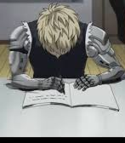
Effective ways to learn mathematics at home
✔ Study examples before solving independently. ✔ Space out math study sessions. (revisit the topic multiple times). ✔ Mix problem types (don’t block by topic). ✔ Think out loud. ✔ Use physical/visual models for tough concepts. ✔ Reflect on errors — don’t just correct them.

Slide 3
Practical tips for answering math problems during an examination.
Do a Quick Scan First (1–2 minutes).
Start with easy ones to build confidence and secure points.
Write Something Immediately.
Blank pages increase anxiety and waste working memory.
Translate the Question.
Many errors come from misreading, not lack of knowledge.
Work Backwards (Especially Multiple Choice)
Eliminate obviously wrong options.
Use Logic even if you can’t fully solve the problem.

Slide 4

Practical tips for answering math problems during an examination.
Draw a Diagram (even if it seems simple).
Diagrams reduce cognitive load and error rates..
Show Clear Steps.
Clear steps help you spot mistakes.
Don’t Let One Problem Steal the Exam.
Spending 15 minutes on one hard problem can cost several easy ones.
Check Units and Signs
Common exam mistakes:
Wrong sign (+/–)
Unit mismatch
Dropping constants

Slide 5
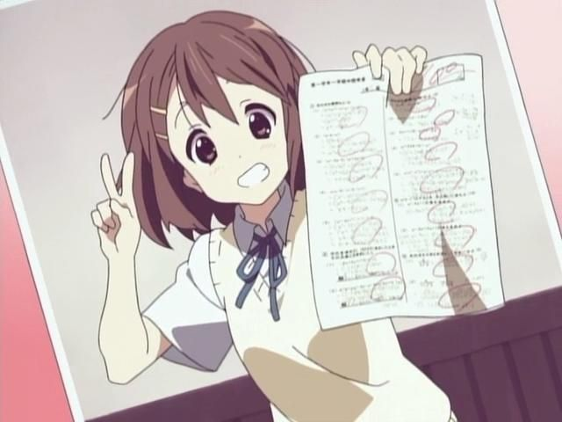
Practical tips for answering math problems during an examination.
Use a 5-Second Reset
Look away, take 2 slow breaths, Resume with a new approach.
Don’t Change Answers Without a Clear Reason.
Studies show first instincts are often correct unless you find a concrete mistake or you misread the question initially.

Slide 6
General Mathematics

Slide 7
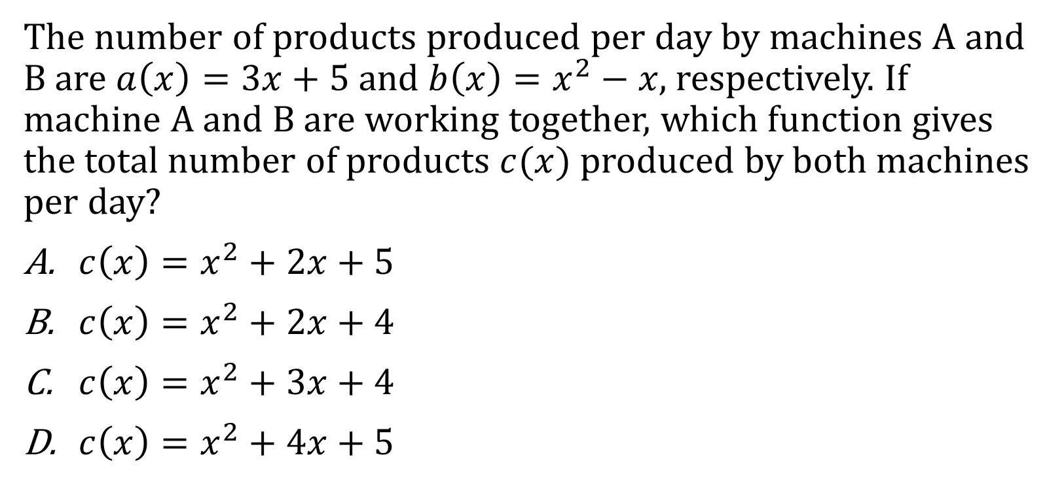
Problem #1 (Elimination Strategy)
The number of products produced per day by machines A and B are $a\left(x\right)=3x+5$and $b\left(x\right)=x^{2}−x,$ respectively. If machine A and B are working together, which function gives the total number of products $c(x)$ produced by both machines per day?
$c\left(x\right)=x^{2}+2x+5$
$c\left(x\right)=x^{2}+2x+4$
$c\left(x\right)=x^{2}+3x+4$
$c\left(x\right)=x^{2}+4x+5$

Slide 8

Problem #2 (Substitution and Check sign)
If the function $y\left(x\right)=2x^{3}+x$ is decreased by $z\left(x\right)=−x^{2}+2$. what value will the new function have for $x=2$?
$6$
12
$16$
$20$

Slide 9
Problem #3 (Same Concepts, Different Terms)
Which strategy gives the x-intercept of any given function?
Solving for the value of x when y is zero.
Solving for the value of y when x is zero.
Finding the value of x that will make the function undefined.
Identifying the leading coefficient of the numerator and denominator.

Slide 10
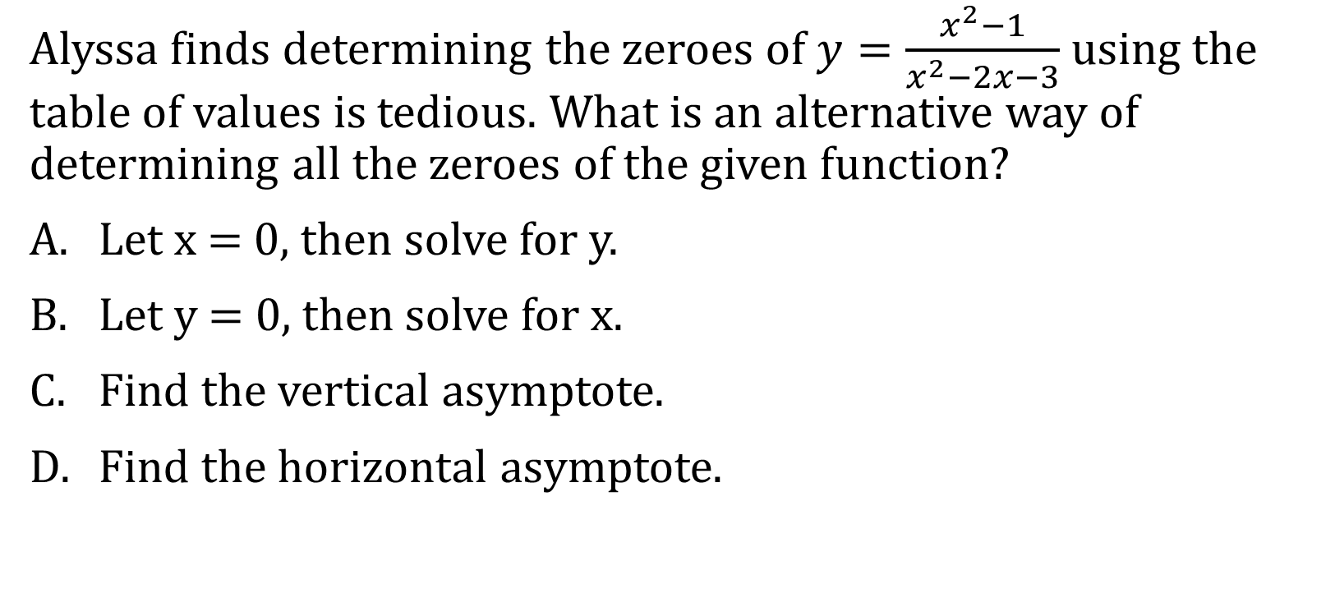
Problem #4(Same Concepts, Different Terms, eliminate the obvious wrong option)
Alyssa finds determining the zeroes of $y=\frac{x^{2}−1}{x^{2}−2x−3}$ using the table of values is tedious. What is an alternative way of determining all the zeroes of the given function?
Let x = 0, then solve for y.
Let y = 0, then solve for x.
Find the vertical asymptote.
Find the horizontal asymptote.

Slide 11
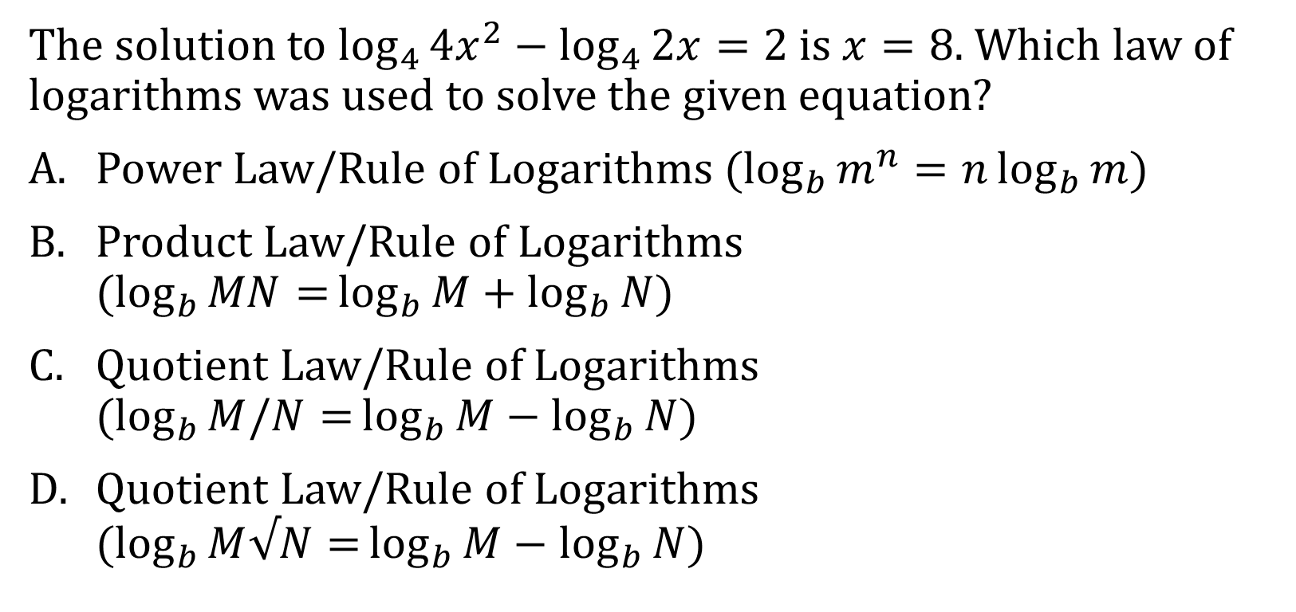
Problem #5(Identifying patterns)
The solution to $\log_{4}{4x^{2}}−\log_{4}{2x=2}$ is $x=8$. Which law of logarithms was used to solve the given equation?
Power Law/Rule of Logarithms ($\log_{b}{m^{n}}=n\log_{b}{m}$)
Product Law/Rule of Logarithms (${\log_{b}{MN=}log}_{b}{M+\log_{b}{N})}$
Quotient Law/Rule of Logarithms (${\log_{b}{M/N=}log}_{b}{M−\log_{b}{N})}$
Quotient Law/Rule of Logarithms (${\log_{b}{M√N=}log}_{b}{M−\log_{b}{N})}$

Slide 12
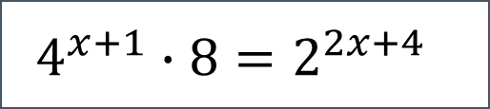

Problem #6(Identifying patterns)
Which of the following will result in the equation in the box?
${32}^{x+1}=2^{2x+4}$
${32}^{x+1}=4^{x+2}$
$4^{x+1}∙4^{2}=4^{2x+1}$
$2^{2x+2}∙2^{3}=2^{2x+4}$
$$4^{x+1}∙8=2^{2x+4}$$

Slide 13
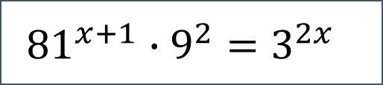
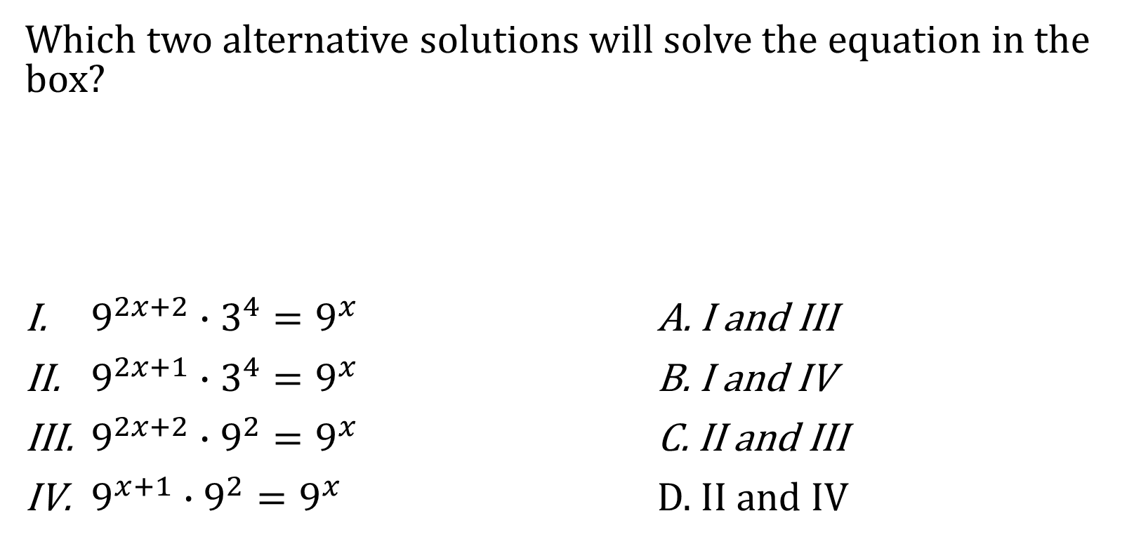

Problem #6(Identifying patterns)
Which two alternative solutions will solve the equation in the box?
$9^{2x+2}∙3^{4}=9^{x}$ A. I and III
$9^{2x+1}∙3^{4}=9^{x}$ B. I and IV
$9^{2x+2}∙9^{2}=9^{x}$ C. II and III
$9^{x+1}∙9^{2}=9^{x}$ D. II and IV
$${81}^{x+1}∙9^{2}=3^{2x}$$
$$3^{4x+4}∙3^{4}=3^{2x}$$

Slide 14
Statistics

Slide 15

Type I and Type II Errors
Mac Cupad and Dina Macuja had been friends for a quite a while, he realize that he likes the girl, and he plans to make a move.
$$H_{0}:The Girl likes him back$$
 | The null hypothesis is TRUE | The null hypothesis is FALSE
Reject the Null Hypothesis
Do not Reject the null hypothesis (Accept Null Hypothesis)
He did not make a move; the girl is labeled “the one that got away”.
He did not make a move, nothing happened Good Job!
He make a move, and they live happily ever after.
He was told that he should focus himself on someone else, it’s the awkward moment! Man down!

Slide 16
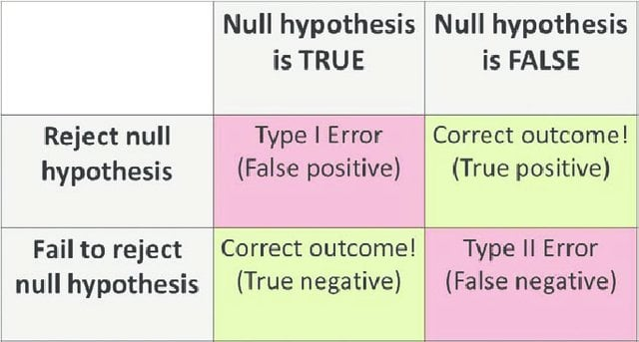
Type I and Type II error

Slide 17
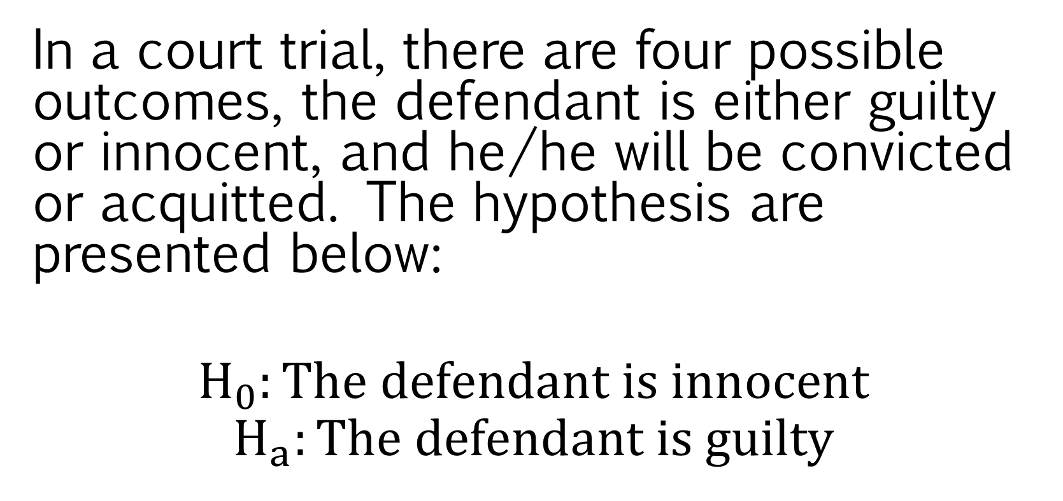
Court Hearing
In a court trial, there are four possible outcomes, the defendant is either guilty or innocent, and he/he will be convicted or acquitted. The hypothesis are presented below:
$$H_{0}:The defendant is innocent$$
$$H_{a}:The defendant is guilty$$

Slide 18
Court Hearing
The judge may commit Type I Error by employing which of the following propositions?
The defendant is acquitted but he is guilty.
The defendant is convicted since he is guilty.
The defendant is convicted but he is innocent.
The defendant is acquitted since he is innocent.

Slide 19
Court Hearing
Which of the following propositions may illustrate a correct action if the null hypothesis is true?
The defendant is acquitted but he committed the crime.
The defendant is convicted since he committed the crime.
The defendant is convicted but he did not commit the crime.
The defendant is acquitted since he did not commit the crime

Slide 20
Null and Alternative Hypothesis
Which decisions generalize a correct action regarding a given null hypothesis?
I. The null hypothesis is rejected when it is true.
II. The null hypothesis is rejected when it is false.
III. The null hypothesis is accepted when it is true.
I and II
I and III
II and III
I, II and III

Slide 21
What does the saying “To see is to believe” mean?
A person only believes if he sees.
A person only sees if he believes.
A person does not believe even if he sees.
A person does not see even if he believes.

Slide 22
Which statement conveys the same message as the saying “To see is to believe”?
If one believes, One sees.
If one sees, One may not believe.
If one does not see, One may believe.
If one does not believe, One does not see.

Slide 23
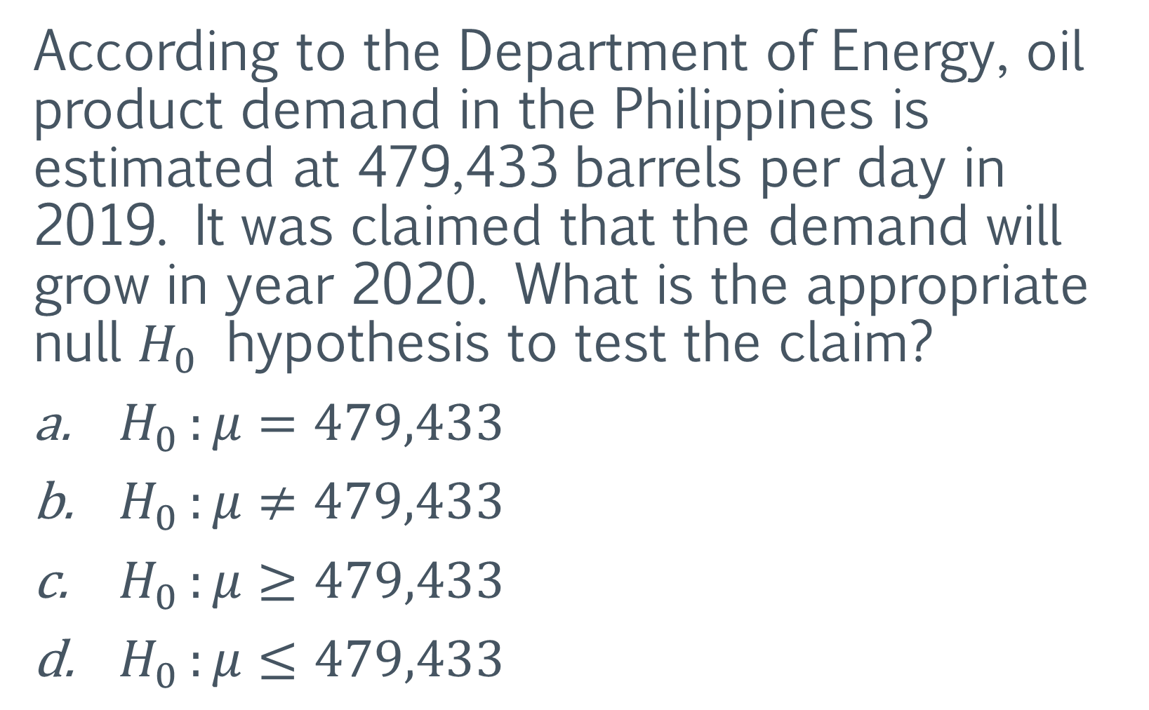
According to the Department of Energy, oil product demand in the Philippines is estimated at 479,433 barrels per day in 2019. It was claimed that the demand will grow in year 2020. What is the appropriate null $H_{0}$ hypothesis to test the claim?
$H_{0 }:μ=479,433$
$H_{0 }:μ≠479,433$
$H_{0 }:μ≥479,433$
$H_{0 }:μ≤479,433$

Slide 24
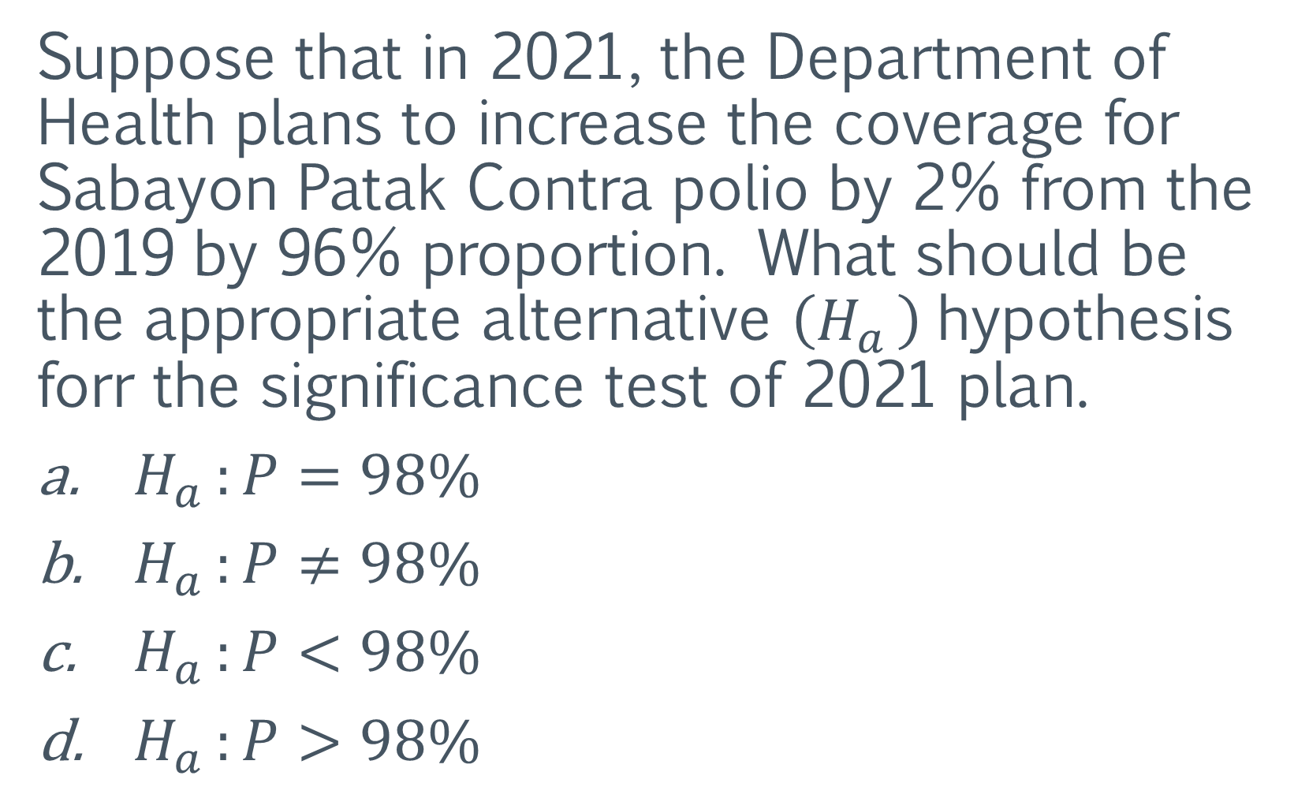
Suppose that in 2021, the Department of Health plans to increase the coverage for Sabayon Patak Contra polio by 2% from the 2019 by 96% proportion. What should be the appropriate alternative $\left(H_{a }\right)$hypothesis forr the significance test of 2021 plan.
$H_{a }:P=98\%$
$H_{a }:P≠98\%$
$H_{a }:P<98\%$
$H_{a }:P>98\%$

Slide 25
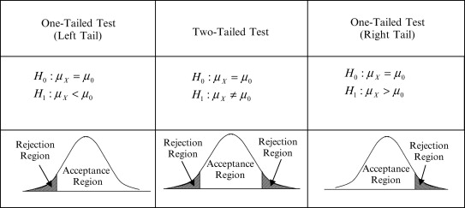
Rejection Zone (T-test and Z-test)

Slide 26
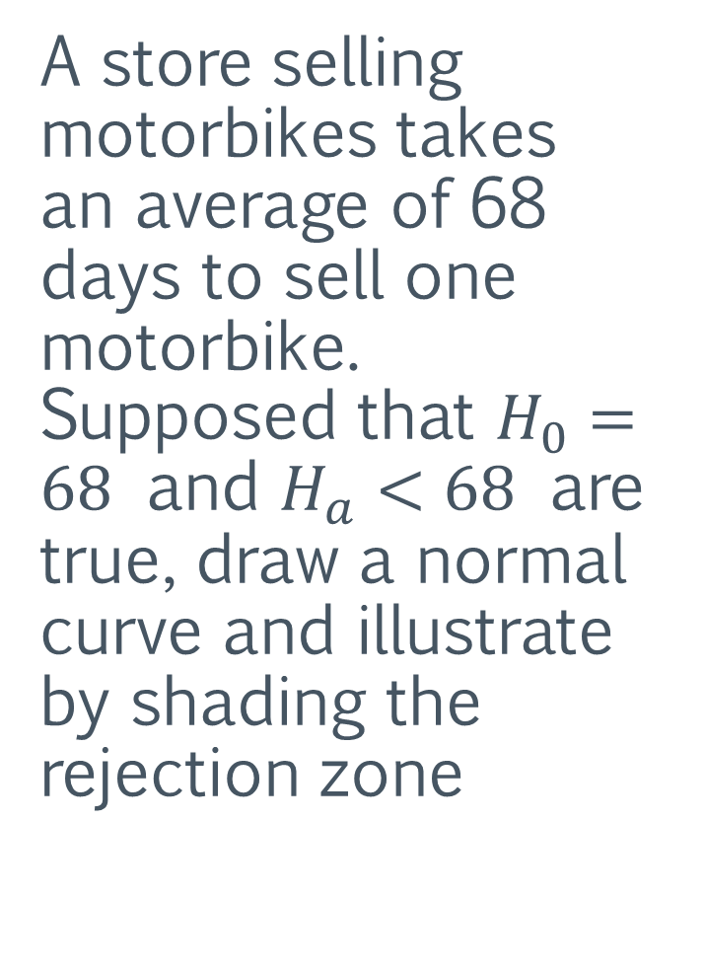
A store selling motorbikes takes an average of 68 days to sell one motorbike. Supposed that $H_{0}=68$ and $H_{a}<68$ are true, draw a normal curve and illustrate by shading the rejection zone

Slide 28
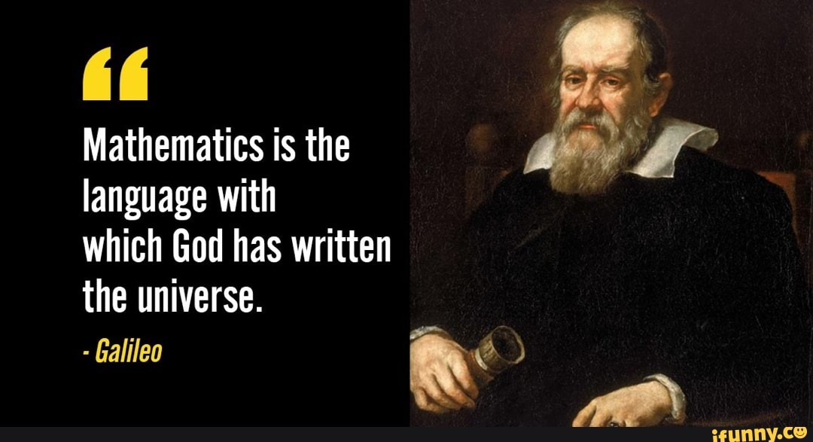

Slide 29


